Slide 1
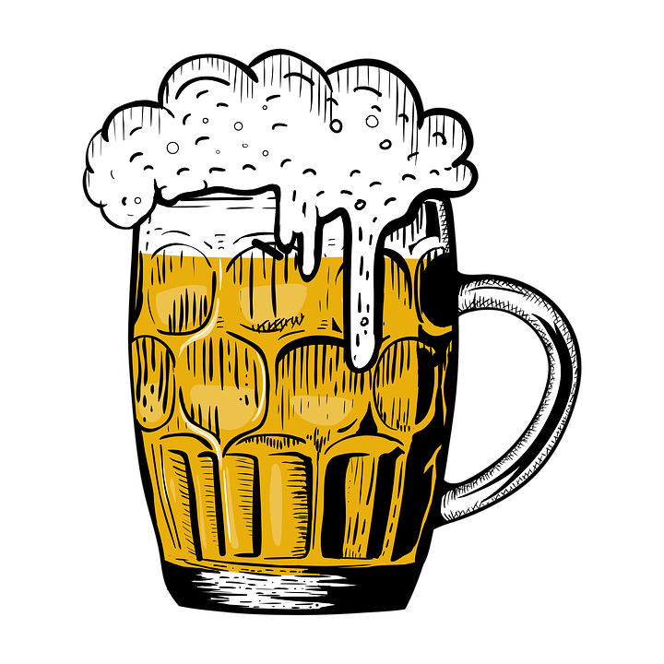
Global Beer Trends
ETL Project
Cameron Kilpatrick, Jacob Stegal, Yash Patel, & Yuli Likhonina
Notes:
YULI

Slide 2
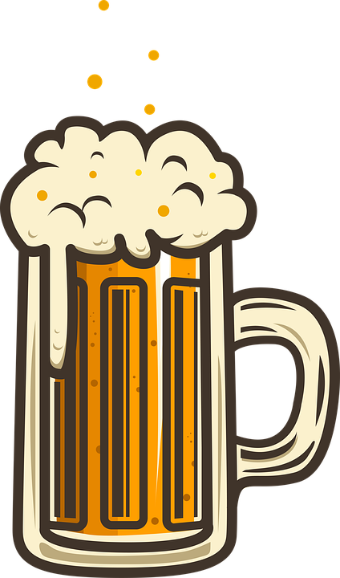
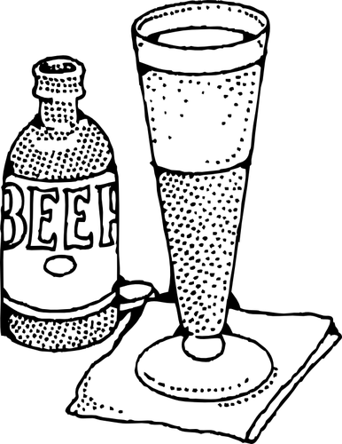
Overview
Motivation:
We love us some beer!
Purpose:
Utilize ETL to create a database to discover leading breweries and beers across the globe based on reviews
Overall Data Question:
What are the most popular beers/ breweries across leading global brewery locations?
Notes:
YULI

Slide 3

Data set exploration
What are the top breweries based on beer reviews?
What are the leading cities, states, and countries for top brewery reviews?
What are the most reviewed breweries across the globe?
What are the most reviewed beer style across the globe?
Notes:
YULI

Slide 4
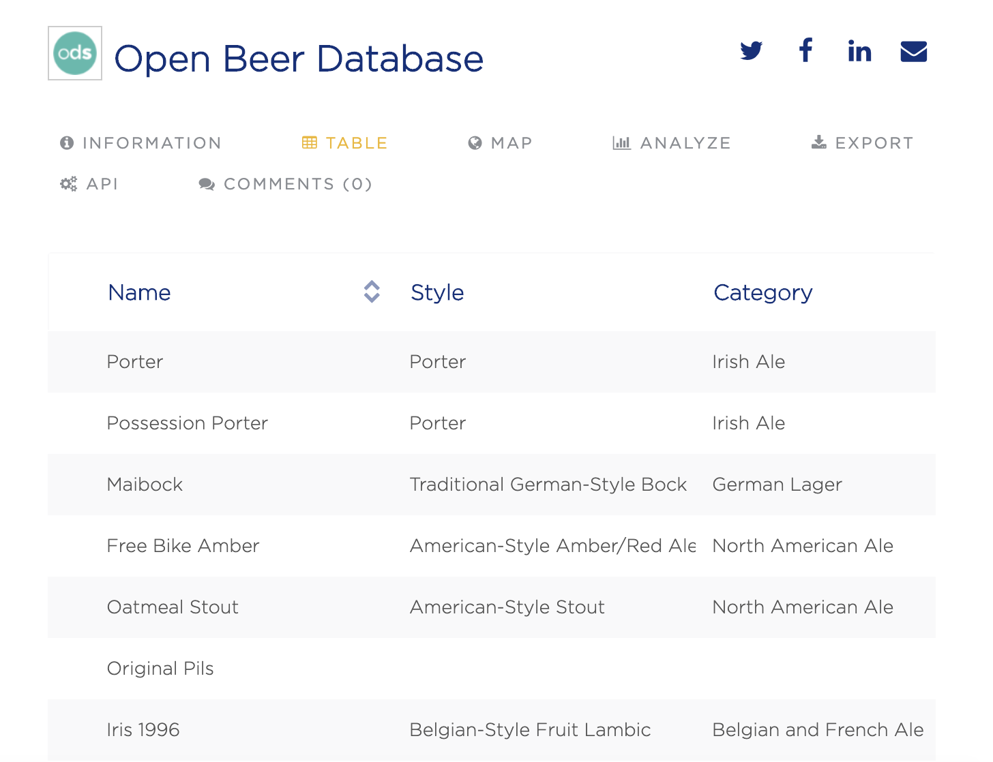
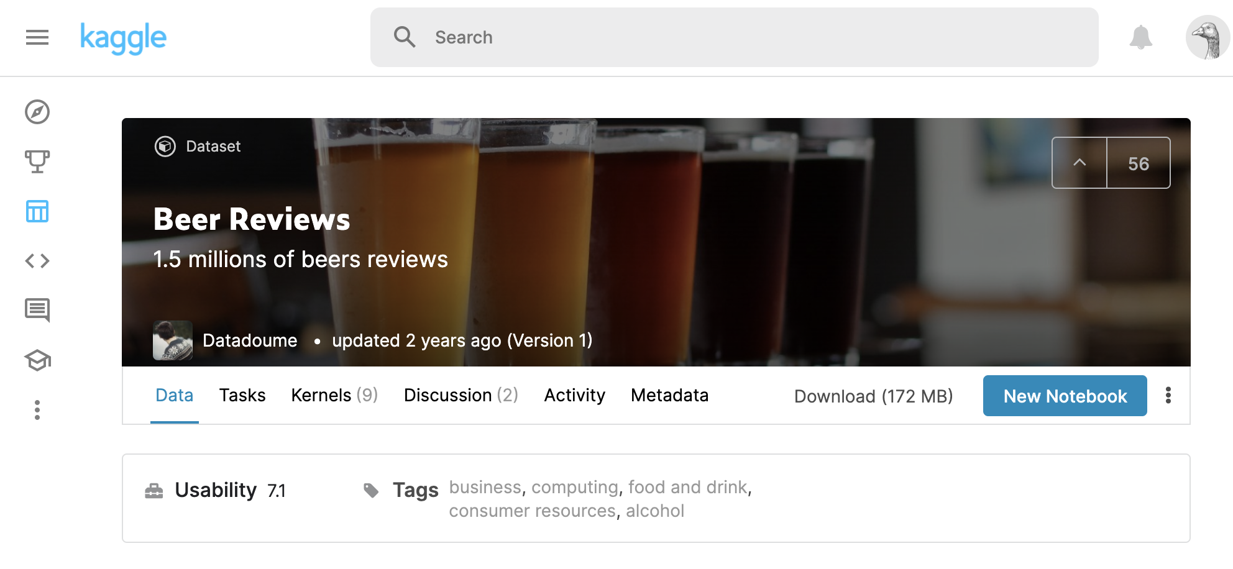
Data Sources
Notes:
YULI

Slide 5
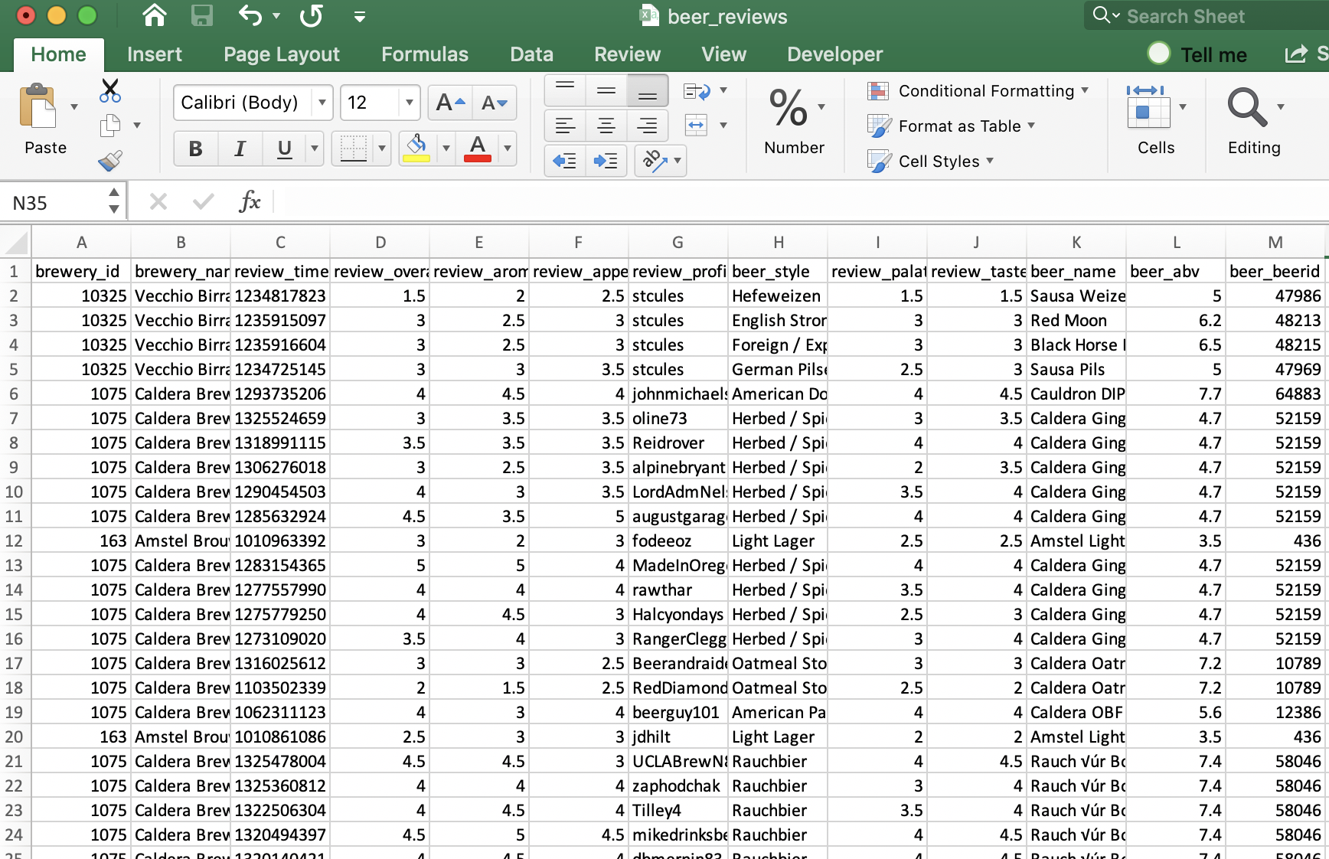
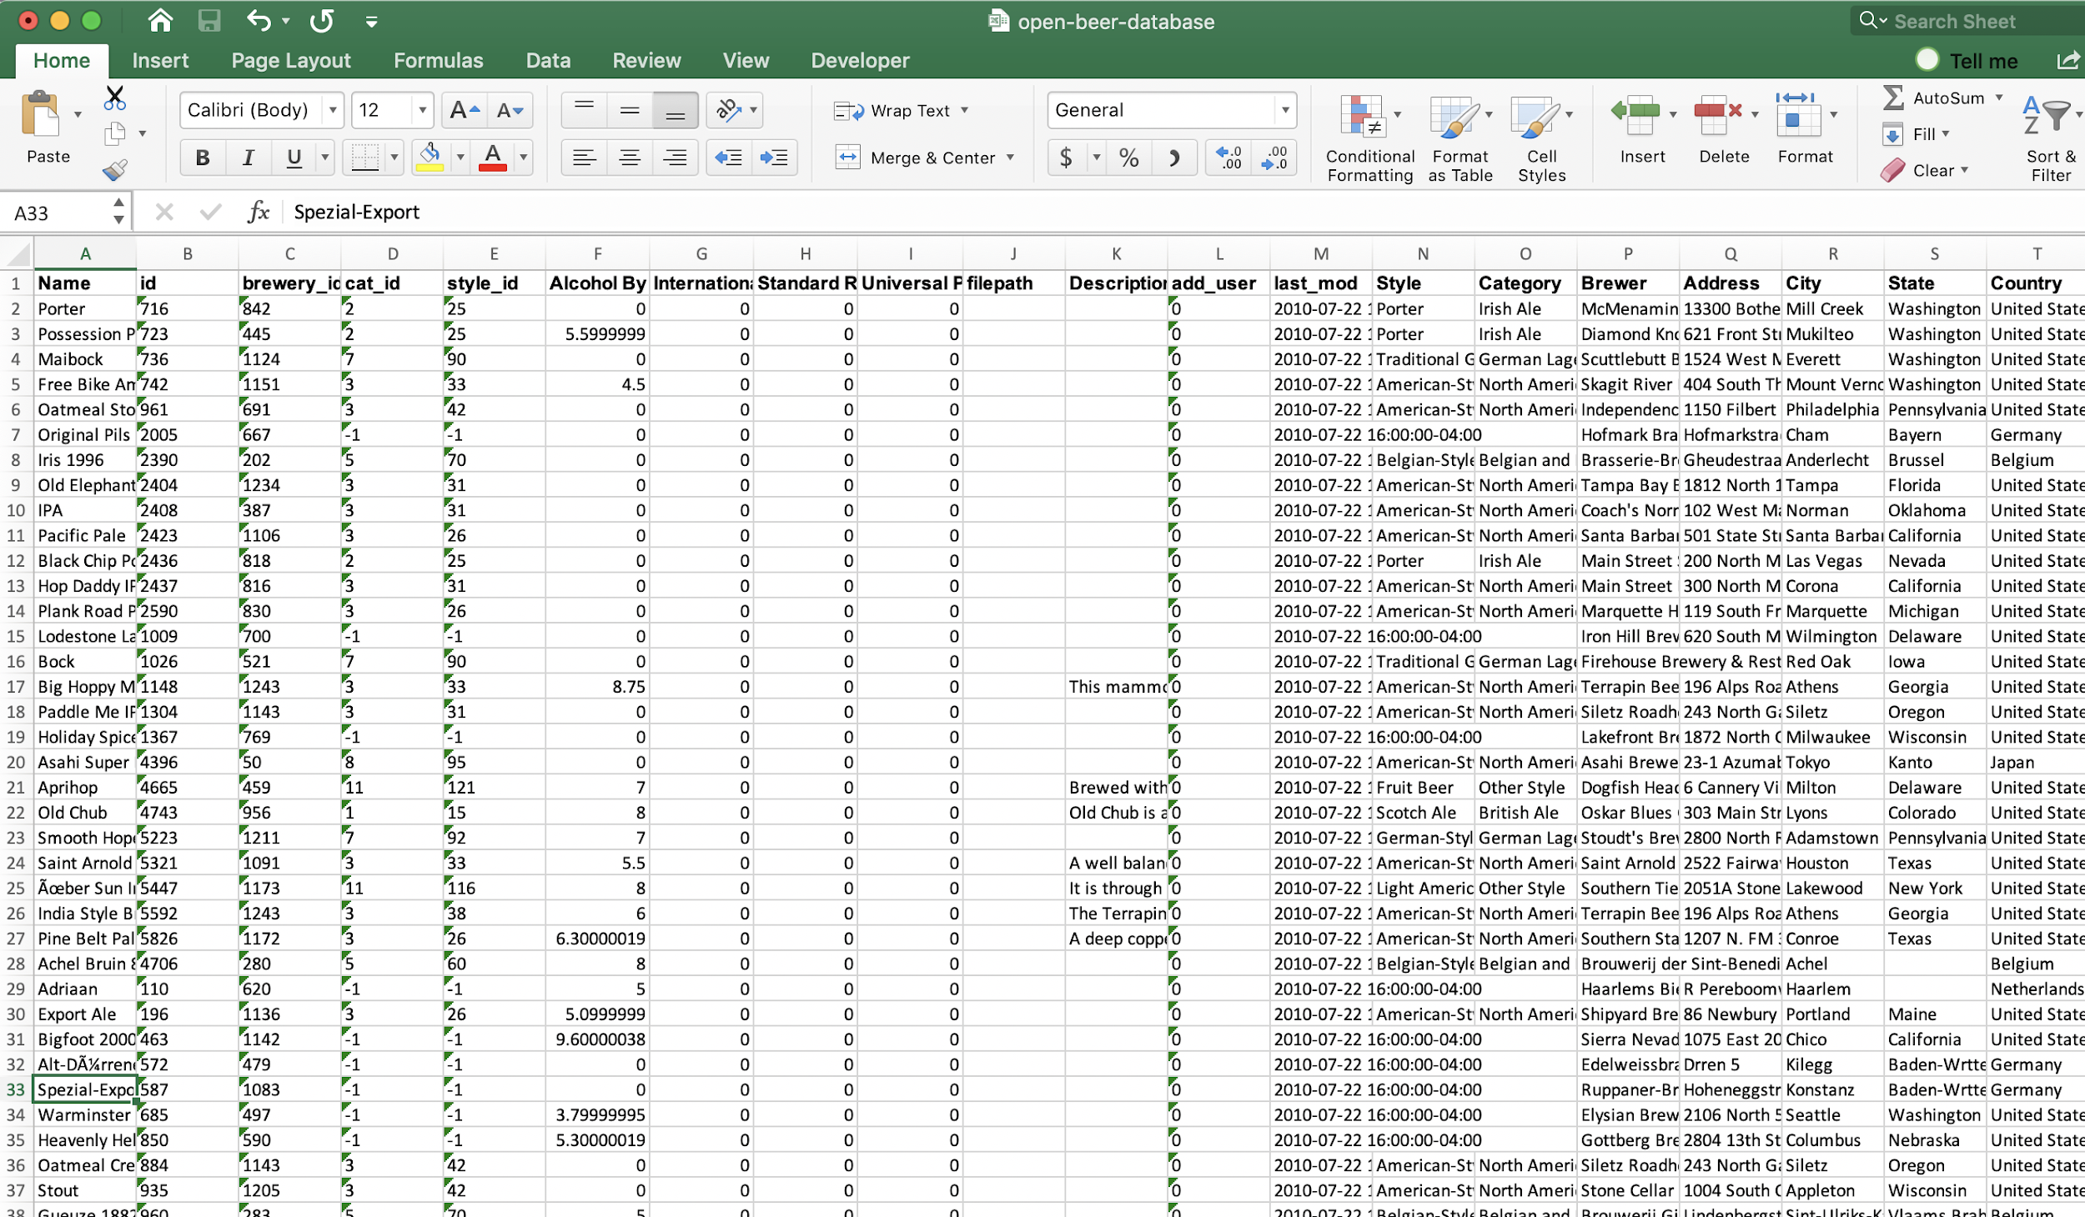
Data Extraction
Notes:
YULI

Slide 6
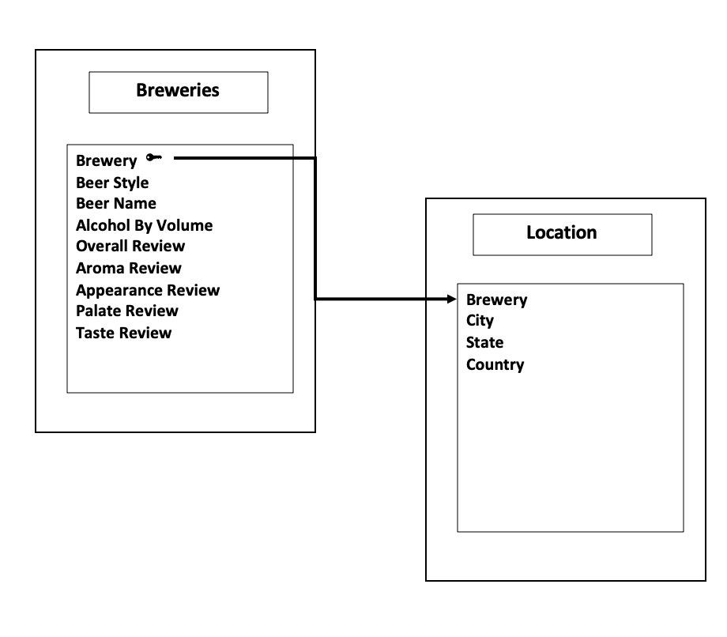
Data Model
Notes:
JACOB

Slide 7
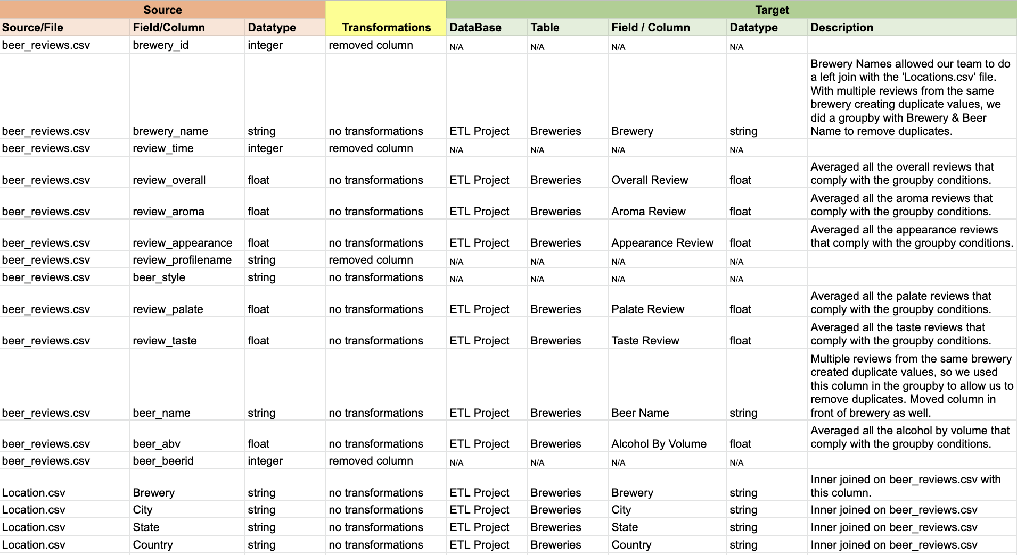
Data Transformation Overview
Notes:
JACOB

Slide 8
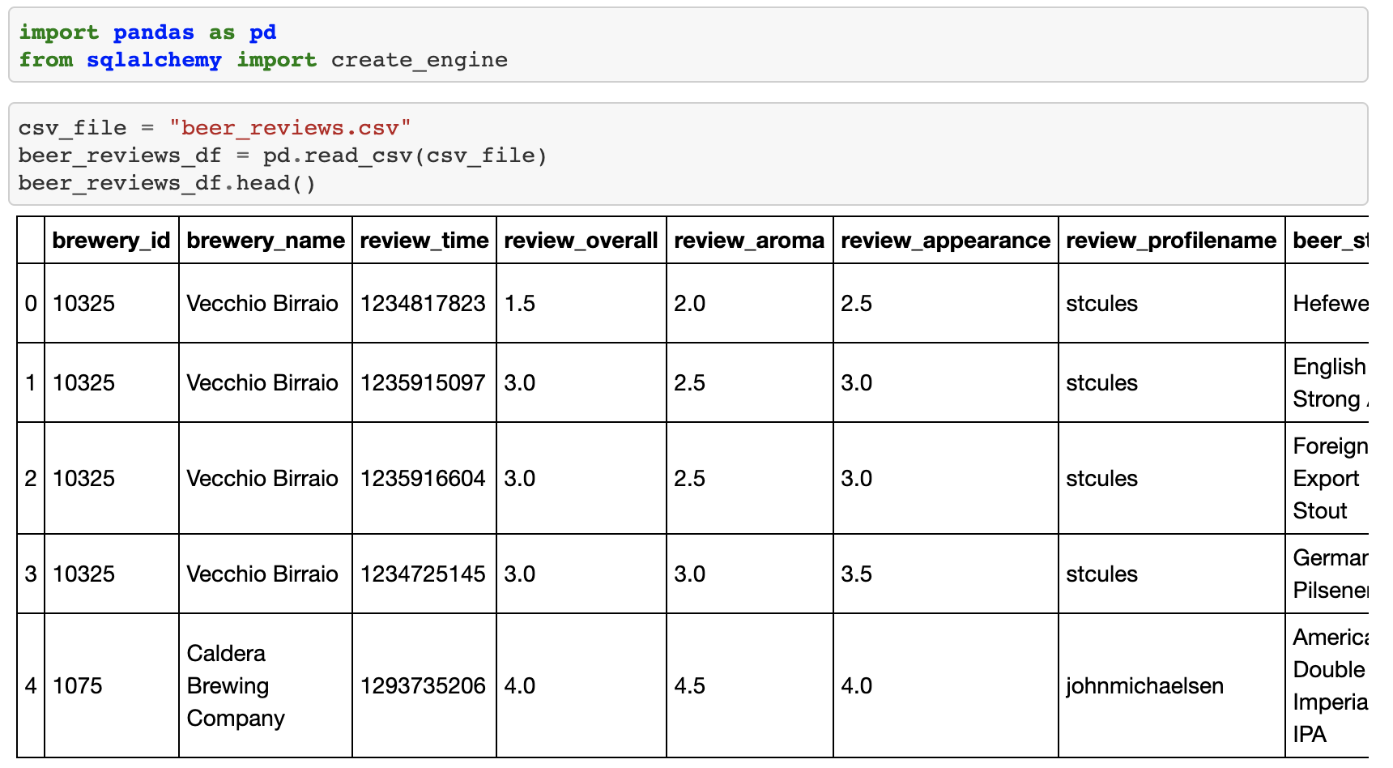
Data transformation Phase 1
Notes:
CAM

Slide 9
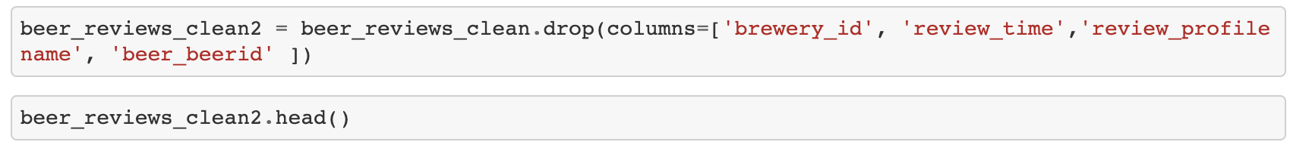
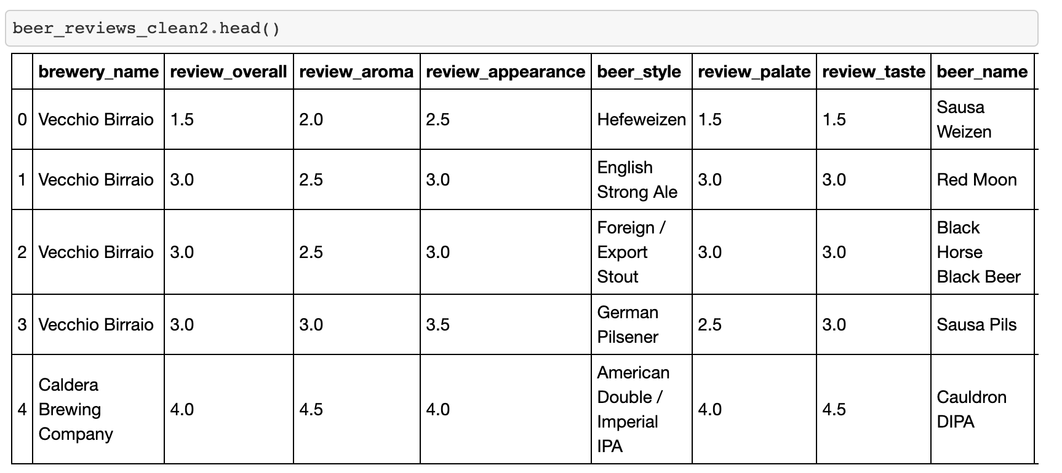
Data transformation Phase 2
Notes:
CAM

Slide 10
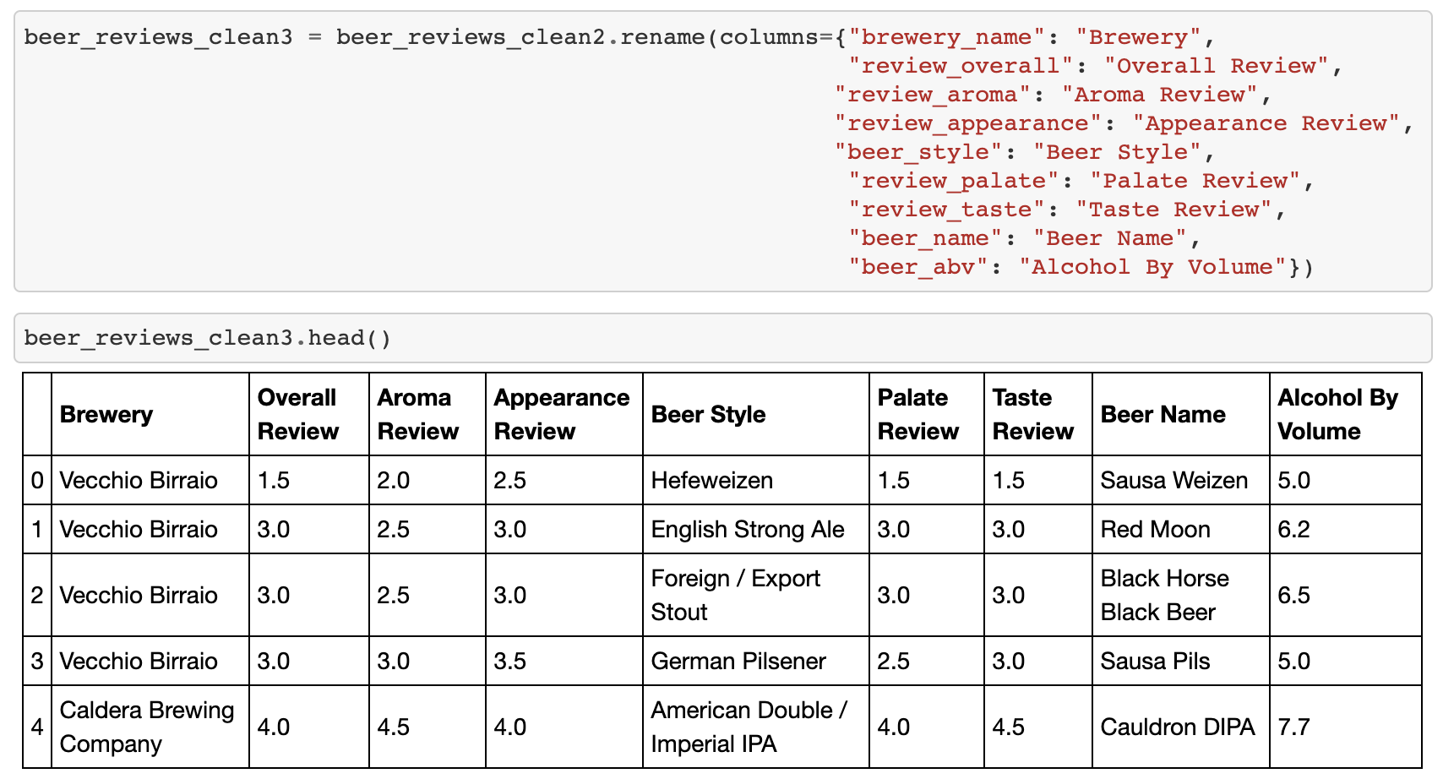
Data transformation Phase 3
Notes:
CAM

Slide 11
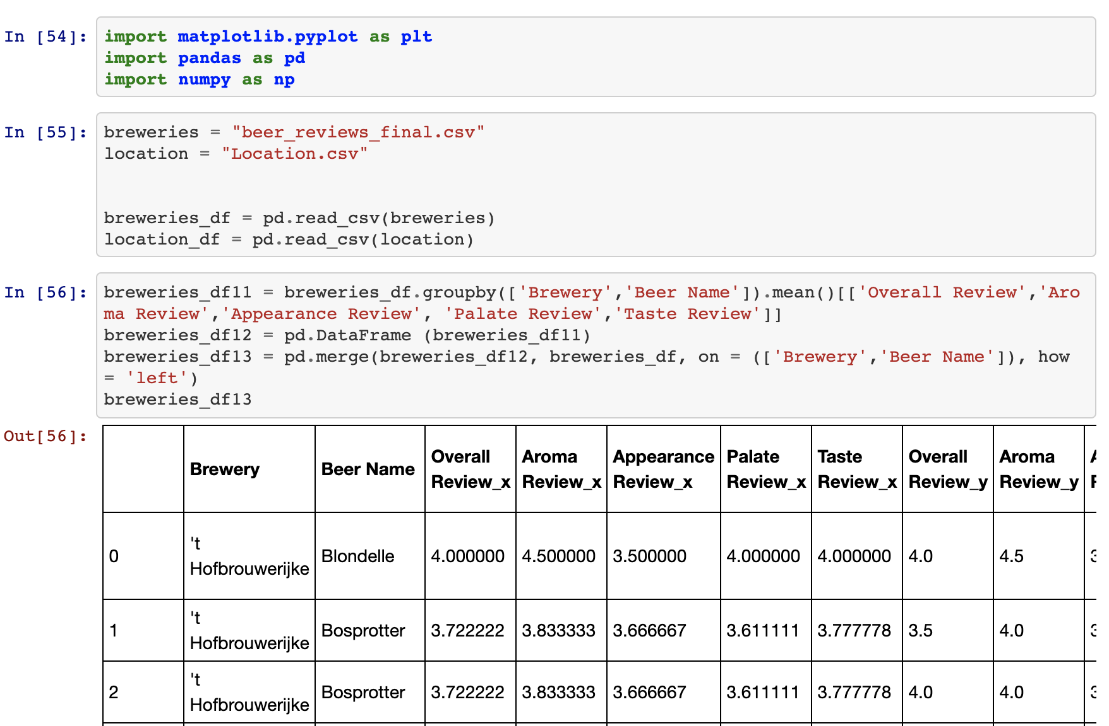
Data transformation Phase 4
Notes:
YASH

Slide 12
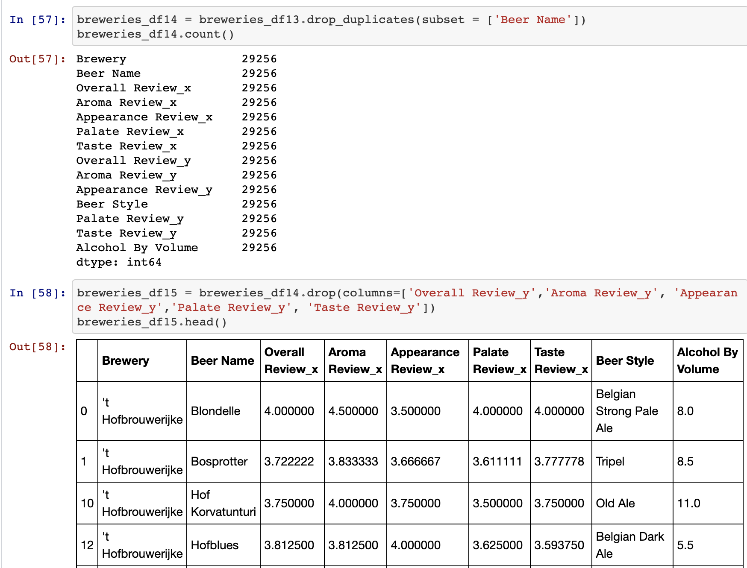
Data transformation Phase 5
Notes:
YASH

Slide 13
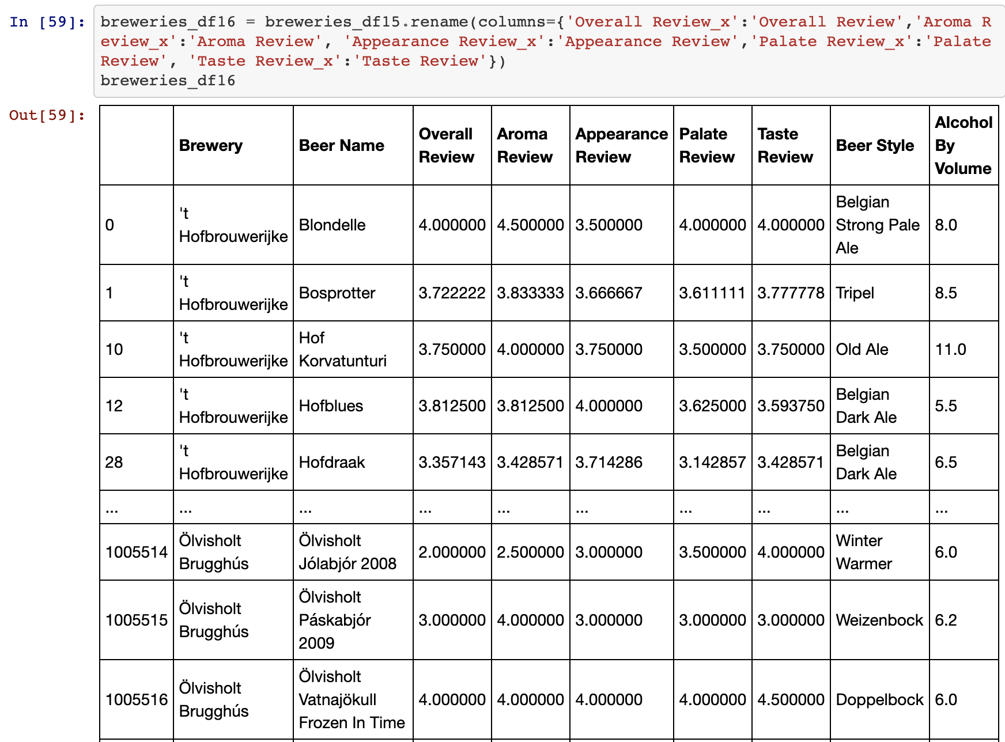
Data Transformation Phase 6
Notes:
YASH

Slide 14
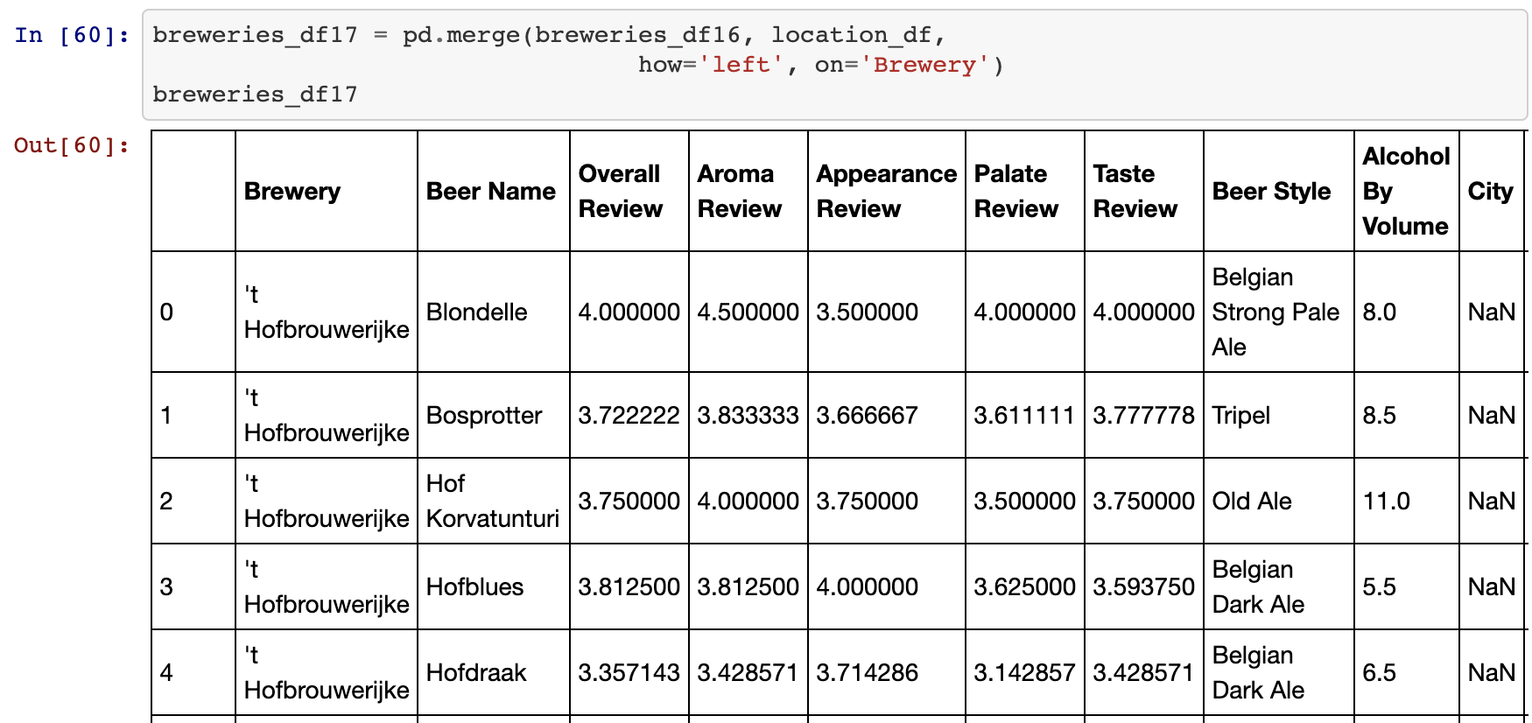
Data Transformation Phase 7
Notes:
YASH

Slide 15
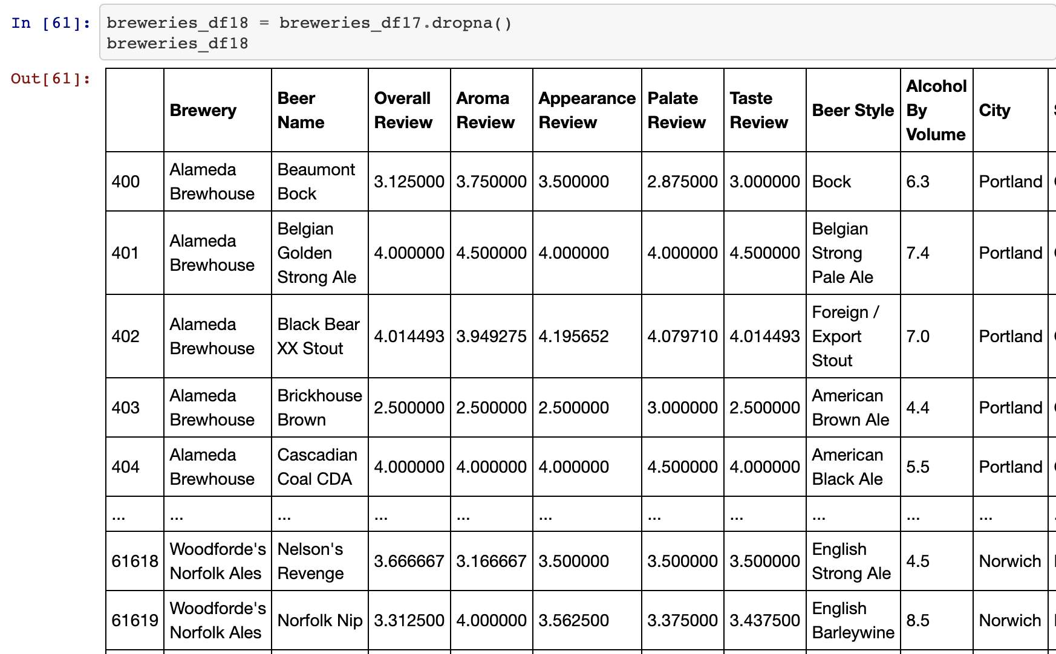
Data Transformation Phase 8
Notes:
YASH

Slide 16
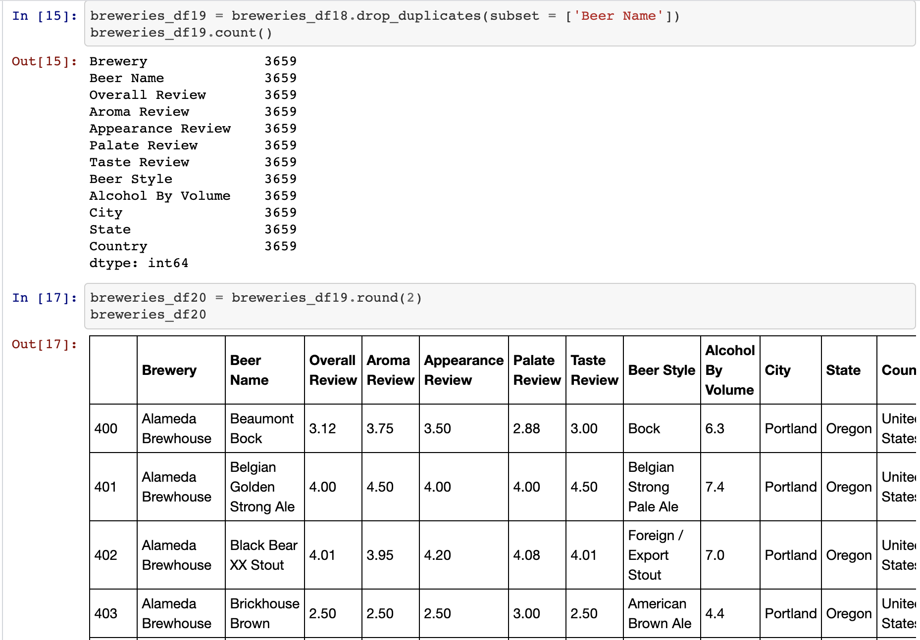
Data Transformation Phase 9
Notes:
YASH

Slide 17
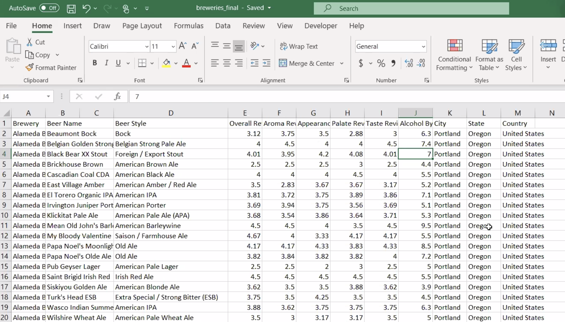
Data Transformation Phase 10
Notes:
YASH

Slide 18
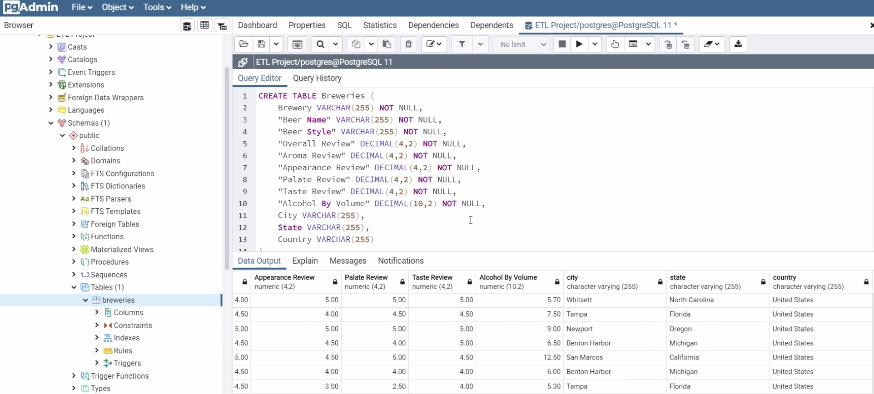
Data load Phase 1
Notes:
CAM

Slide 19
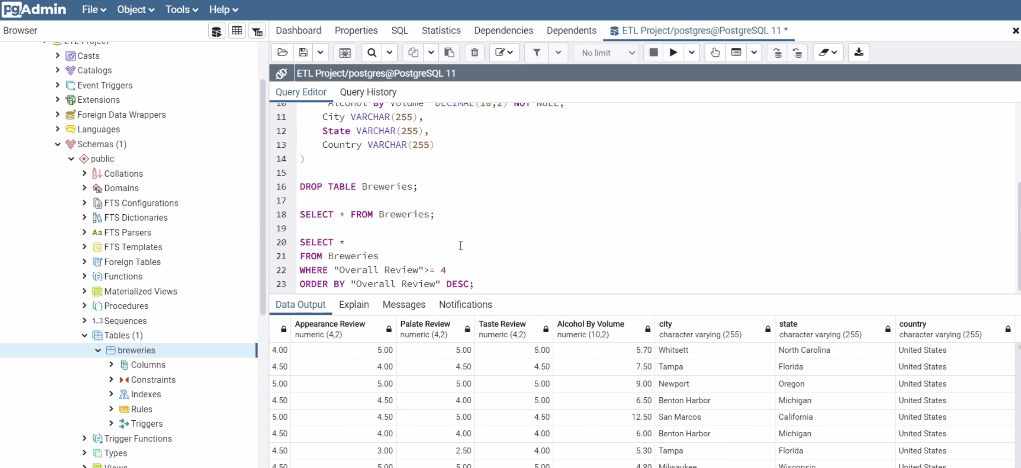
Data load Phase 2
Notes:
CAM

Slide 20
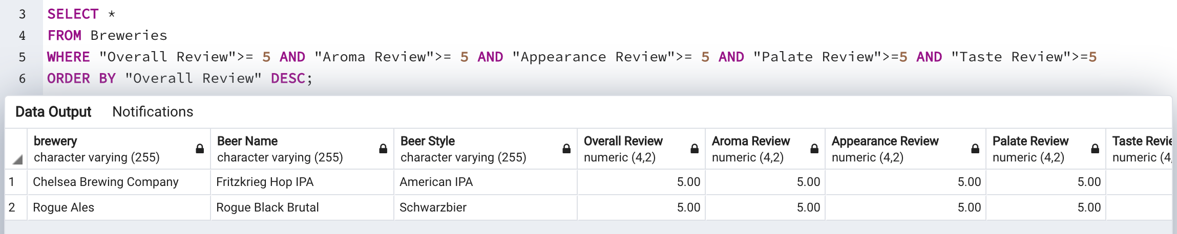
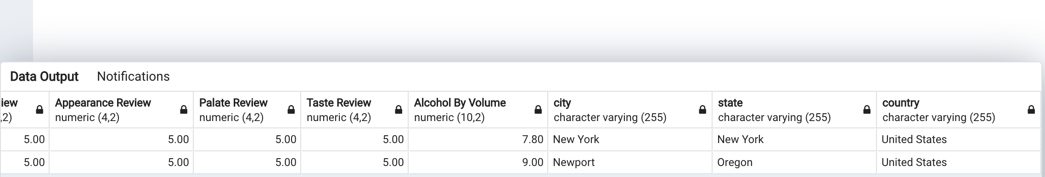
Highest Overall Rated Breweries
Notes:
CAM

Slide 21
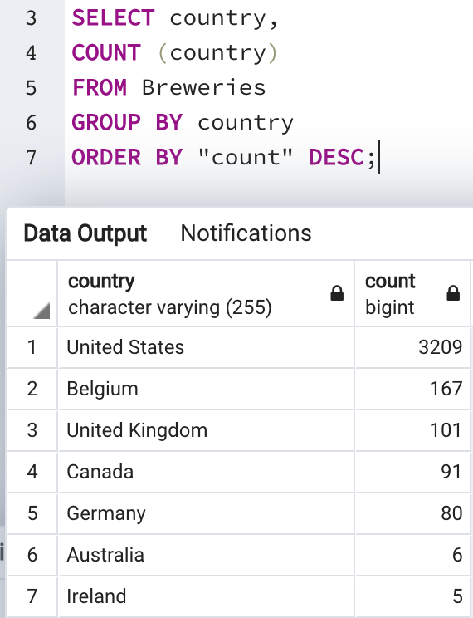
Review Count by Country
Notes:
YULI

Slide 22
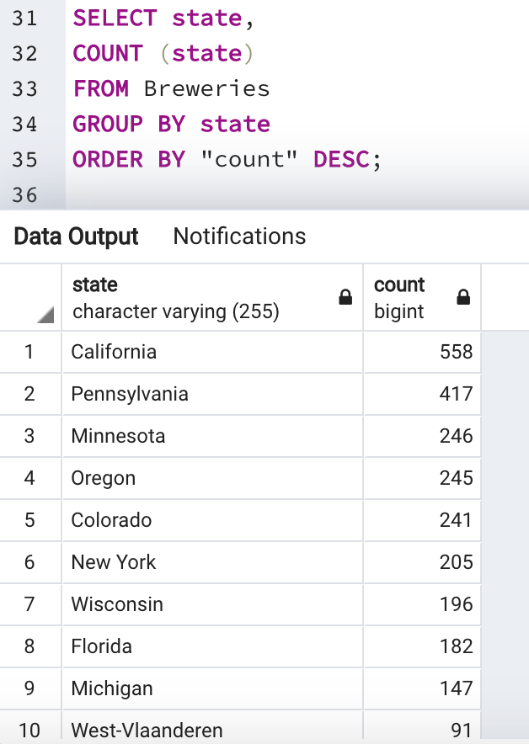
Review Count by State
Notes:
YULI

Slide 23
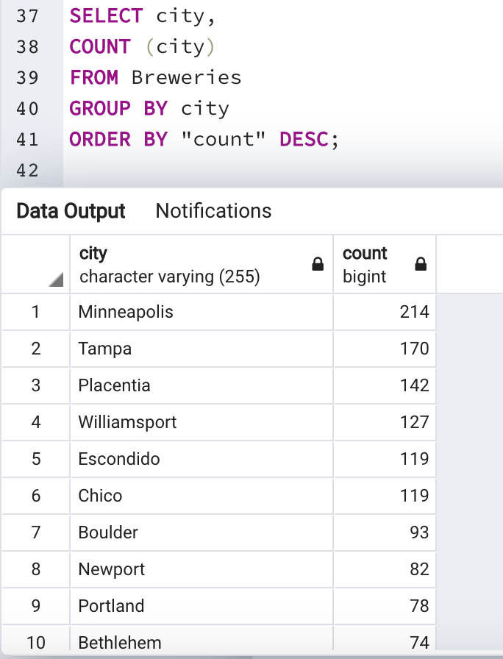
Review Count by City
Notes:
YULI

Slide 24
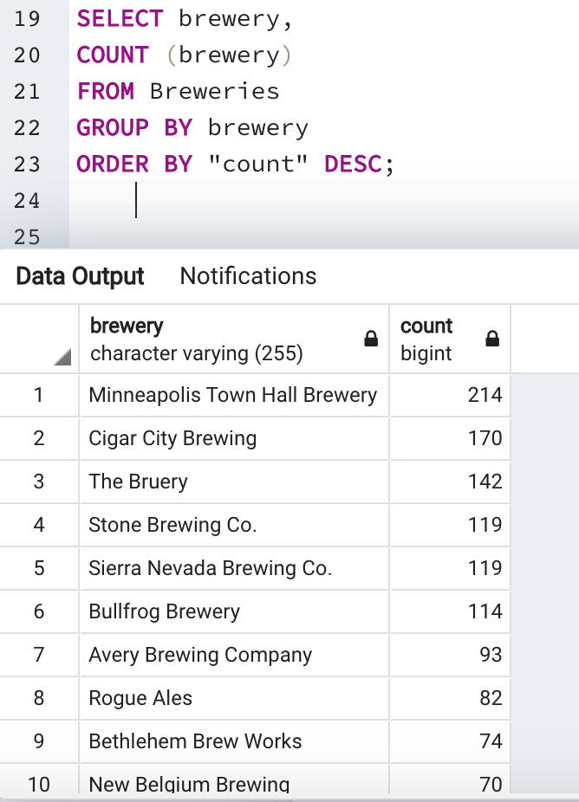
Review Count by Brewery
Notes:
JACOB

Slide 25
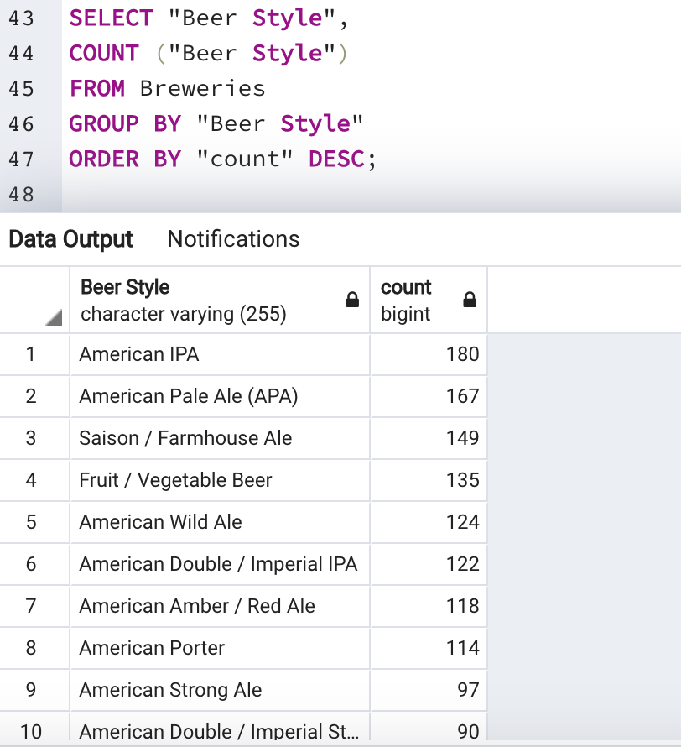
Review Count by Beer Style
Notes:
JACOB

Slide 26
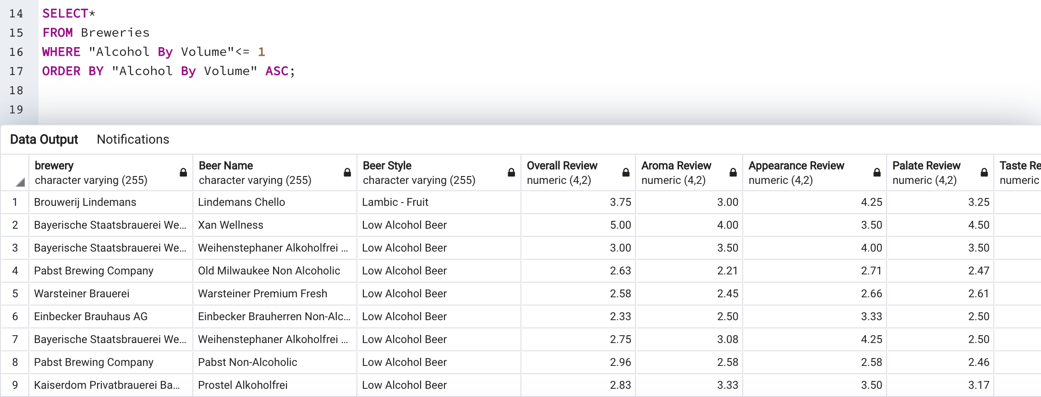
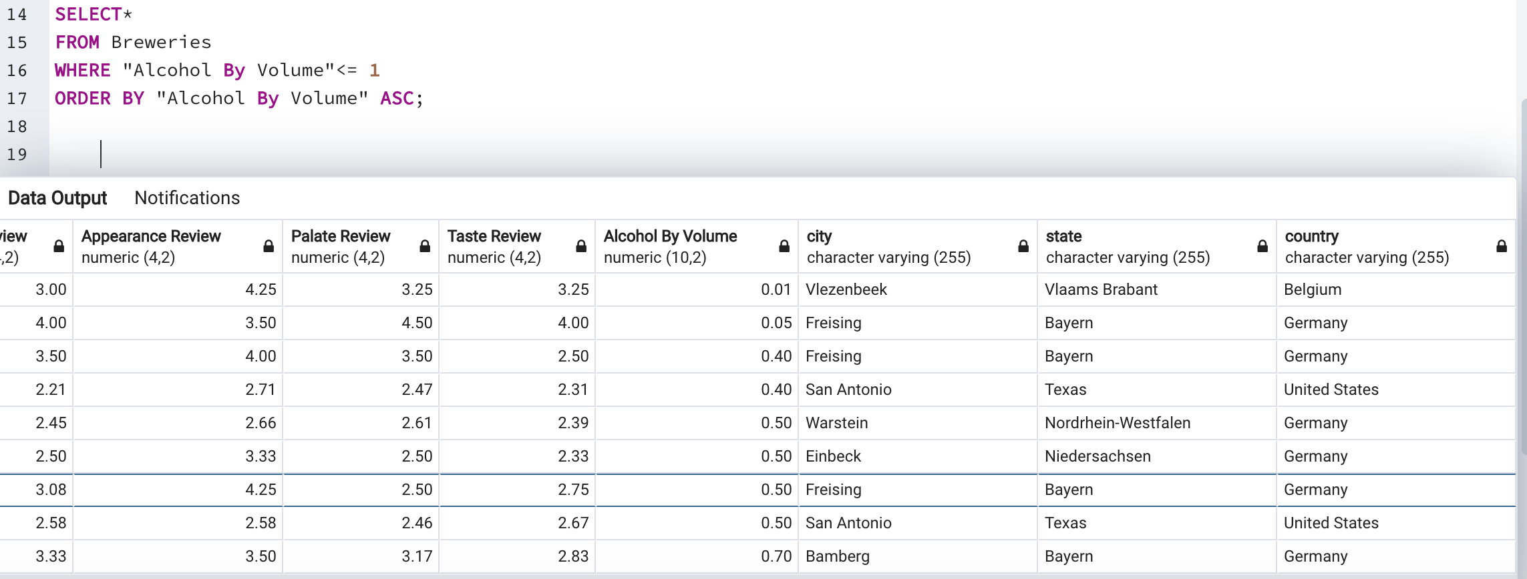
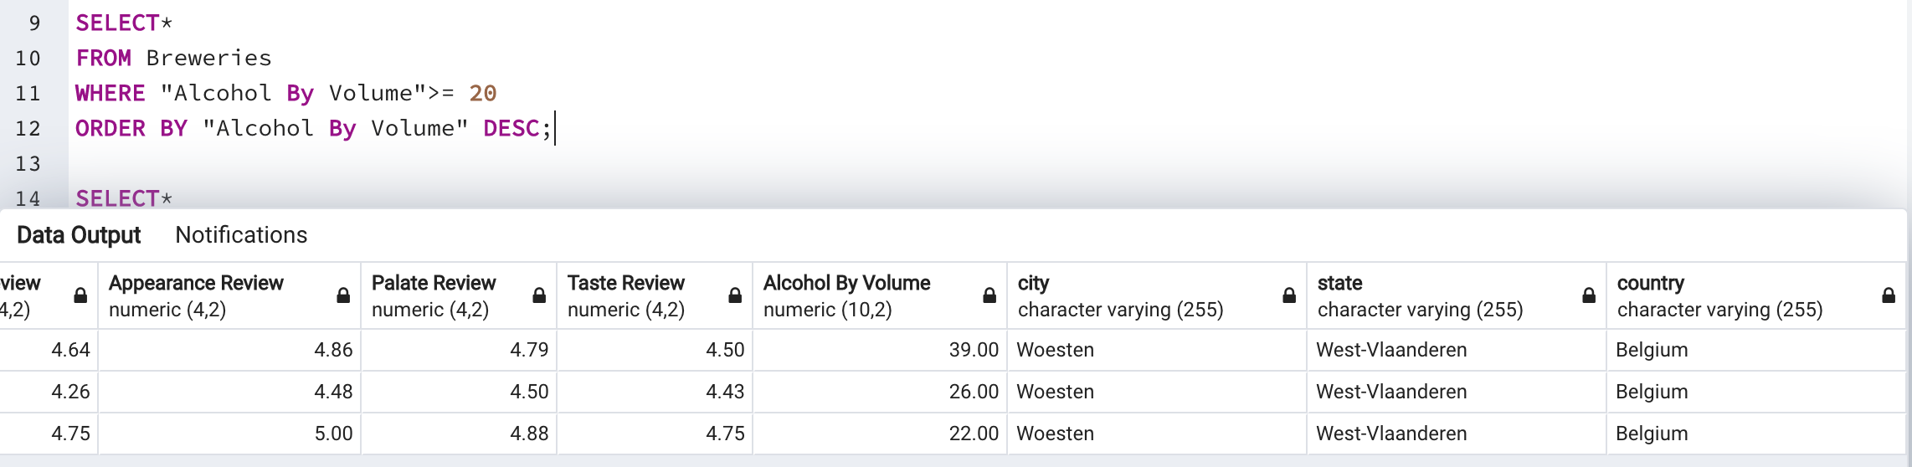
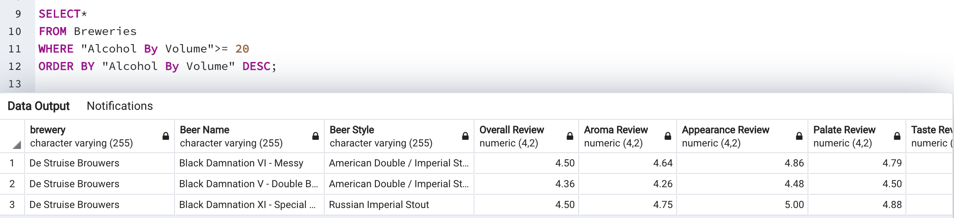
Comparison By ABV
Notes:
JACOB

Slide 27
Global Beer trend conclusions
What are the top breweries based on beer reviews?
Chelsea Brewing Company & Rogue Ales
What are the leading cities, states, and countries for top brewery reviews?
Cities : Minneapolis, Tampa, Placentia, Williamsport, and Escondido
States: California, Pennsylvania, Minnesota, Oregon, and Colorado
Country: United States, Belgium
What are the most reviewed breweries across the globe?
Minneapolis Town Hall Brewery, Cigar City Brewing, and The Bruery
What are the most reviewed beer style across the globe?
American IPA, American Pale Ale (APA), and Saison/ Farmhouse Ale
Notes:
YULI

Slide 28

cheers!
Notes:
Q&A

